Slide 1
Design of Software Systems CS 509
Fall 2022
Prof. George Heineman
WPI
heineman@cs.wpi.edu

Slide 2
Last Lecture Recap And Outline
Lecture Recap
Office Hours Monday in person now 1:00 – 2:00 pm
Office Hours Wednesday Nights 7:30 – 19:30 pm
HW1.Code due September 27th 6:00 pm (one week)
Weekly Lecture Topics
Groups have been assigned
HW1 final questions and discussion
What is an interface?
How does interface appear in distributed systems?
Post client-server, pre-cloud based design
Group designation
Use Cases for Group Project [gold standard]
Swagger Design

Slide 3
Final Thoughts For HW1 GUI
Perfectly acceptable to choose minimal GUI design
Review my sample applications for details
Functionality is only concern
Pay attention to the required concrete scenarios and be sure you can satisfy them as they are written
Submission process
Zip up src/ folder from within your React folder – this way you don’t zip up 280 MB of content. I only need to see the source
Submit in Canvas HW1
Due 6:59 PM September 27th

Slide 4
What Is A Base Class
A base class defines a useful concept in your domain (whether Application Domain or Solution Domain)
Object instantiated from classes
Consider java.lang.Object
equals(obj) defaults to this == obj
toString() includes class name in default string
hashCode() defaults to internal integer
These capabilities could be considered to be behaviors
Extending a base class closely couples the subclass to the superclass
Subclass inherits attributes as defined by the superclass
Open Question: Why is there no int compareTo(obj) method defined for java.lang.Object?

Slide 5
What is an Interface
The collection of available methods to invoke?
This seems rather arbitrary and rather a large space!
Before object-oriented programming languages, one could only restrict functions for visibility
Some languages offer inner functions that can’t be accessed
def mine():
x = 5
def t():
return 7
return x + t()
print (mine())

Slide 6
What is a Java Interface
An interface is an abstract type used to specify a behavior that a class must implement
Different from an abstract class since it doesn’t imply shared state
Java 8 added ability to have default implementations which “blurs” the distinction a bit between classes and interfaces
Done to allow future changes to interface without breaking older clients (more on this later)
If a class T supports ability for full ordering of its objects…
Then class should implement Comparable<T>
Classes implementing Comparator<T> extract that capability

Slide 7
Superclass vs. Interface
Abstract Class
An abstract class does not allow objects to be instantiated from it
It supports specialization by subclasses
Any subclass that extends this class must provide implementations of all declared abstract methods
Benefit: can still encapsulate state and data to support subclasses
Interface
Defines a subset of behavior
Represented as a collection of method signature declarations
Any class that implements this interface must provide implementations of these method declarations
Benefit: Class can implement any number of interfaces
public interface Iterator<E> {
boolean hasNext();
E next();
void remove();
}

Slide 8
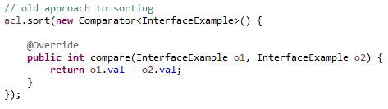
How Many Ways Can You Sort a List?
Consider an ArrayList<T> for some type T
Manually
Manipulate elements to insert, remove based on ordering for T
Using comparator object
ArrayList has method sort(Comparator<? super T> comp)
Any object that implements interface can be used
Functional

Slide 9
Client :: Interface :: Server
C1
IService
S1
S2
Client ensures PRE
Server ensures POST
How does client C1 know how to communicate with S1?
When can S2 be replaced for S1?

Slide 10
Design by Contract
Interfaces must
Declare pre-condition for each method
Declare post-condition for each method
Defines required service expected by client
Defines provided service guaranteed by server

Slide 11
Polymorphism
Substitutability
Interface pre/ post conditions
(pre) I (post)
Classes implement interfaces
may weaken pre condition (accept more)
may strengthen post condition (restrict)
Clients of interfaces
may strengthen pre condition (restrict)
may weaken post condition (accept more)

Slide 12
Specific Example
Contravariance
Function has domain and range
Two implementations of log(x) in given domain of -1 < x < 1
/**
* Interface defining core functionality.
*/
public interface ICalculation {
/**
* Return natural log of (x+1).
*
* Precondition: 1 > x > -1
*
* Contract: Produce at least 5 digits of
* precision.
*
* @param x value as a float.
*/
public double compute (float x);
}

Slide 13
Two Implementations
Which implementation is suitable for use?
Depends on the nature of “satisfying the contract”
/**
* Compute ln (1+x).
*
* Precondition: x > -1
*
* WEAKER precondition.
*/
public double compute(float x) {
return Math.log(x+1);
}
/**
* Using Maclaurin Series, we know that
*
* ln(1+x) = x - x^2/2 + x^3/3 - x^4/4 + ...
*
* Precondition: 1 > x > -1
*/
public double compute(float x) {
double result = x;
double numerator = x;
for (int term = 2; term < numTerms; term++) {
numerator *= -x; // alternates
result += numerator/term;
}
return result;
}

Slide 14
Covariance & Contravariance
f(x) vs. g(x)
dom(f)
range (g)
dom(g)
range (f)
contravariance
covariance
Function g can be used safely where function f had been used if the above relationships hold

Slide 15
Contravariance
Method pre conditions
Input parameters
Provider may expect less than interface demands
i.e., boolean equals(Object o) in class Something
Your implementation of Something can accept different objects than just Something
Replace
input types with more general subtypes

Slide 16
Covariance
Method post conditions
Output parameters and return values
Provider may establish more than interface demands
Part p = findPart(99); // returns SpecialPart object
Replace
output types with more specific subtypes
Supported by programming languages
See code example DesignPatterns/covariance

Slide 17
Liskov Substitution Principle
Contravariance & Covariance
Apply to types
S is a subtype of T if
object of type S can be substituted in all places where T is expected
At heart this is about substitution
Typing is critical
Only way that compiler knows code is “correct”

Slide 18
Law Of Demeter
Concept helps programmers reduce complexity
Principle of Least Knowledge
“Inside of a method M, with what other objects can M communicate?”
Note: M can always access any globally accessible object within the scope of M.
public class C {
Other other;
...
public void M(Item i) {
Special s = new Special(...); Exotic e = s.doSomething();
}
}
Methods in C (“this”)
Attributes in C (“other”)
M’s parameters (“i”)
Objects instantiated in M (“s”)
Seek to avoid sequences of “.”
s.doSomething().another().last()

Slide 19
Apply These Concepts To System Level
Interface ➔ Application Programming Interface (API)
Locate API service provider
No longer compile time consideration but might involve dynamic lookup via proxy
Invoke API method
Not method invocation, but now involves robust protocol, i.e., HTTP
Concepts such as Idempotent apply here, which means that calling the method multiple times is equivalent to calling just once
Return values from an API method
Synchronous and caller must block (as with method call)
Asynchronous and caller must poll (similar to low-level OS)
Asynchronous and caller is notified (a push model)

Slide 20
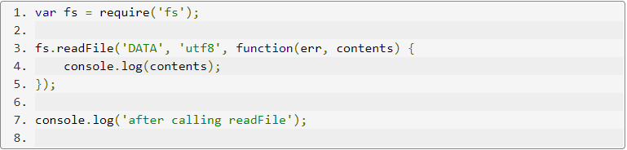
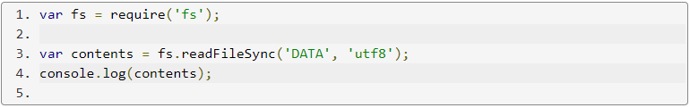
Small Example
Asynchronous invocation
Synchronous invocation

Slide 21
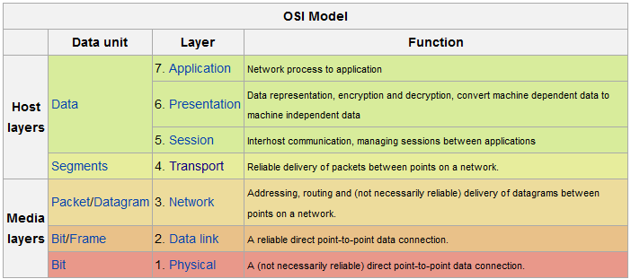
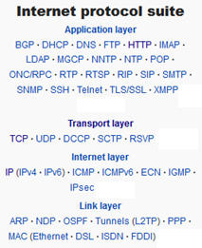
Computer Networking Prior 1996
TCP/IP is the computer networking model and communications protocols used in the Internet
Transmission Control Protocol (TCP) provides reliable, ordered and error-checked delivery of a stream of octets
Internet Protocol (IP) specifies how to relay datagrams across network boundaries

Slide 22
Hypertext Transfer Protocol [1996]
An application protocol for distributed, collaborative, hypermedia information systems
HTTP clients issue requests to an HTTP server who issues response
Get – request representation of specified resource
Post – asks server to accept the entity enclosed in the request as a new subordinate of given URI
HTTP resources are identified and located on the network by Uniform Resource Identifiers (URIs)

Slide 23
Browsing Since Birth
Retrieve content via a browser
https://www.monticello.org/sites/default/files/uploaded-content-images/Declaration_Pg1of1_AC_atNARA_0.jpg
GET request
Send content to a website (or perform action)
POST request
POST vs. GET (link)

Slide 24
REST Architectural Style
Representational State Transfer [link]
Principled Design of the Modern Web Architecture [URL]
Stateless
Request from client contains all information to service request
Session state is held in the client [can be stored on server]
Client initiates request and is “in transition” until response
Representation of application state in response contains embedded links for next time

Slide 25
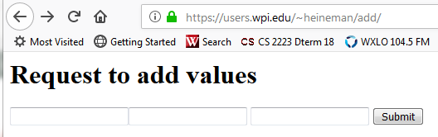
Simplest Dynamic WebSite
http://users.wpi.edu/~heineman/add
Enter in values (first two text fields) and submit
Computes result

Slide 26
Manual HTTP GET request via Telnet
Response issued to a Request
Request has Header and Body
% telnet users.wpi.edu 80
Trying 130.215.36.39...
Connected to users.wpi.edu.
Escape character is '^]'.
GET https://users.wpi.edu/~heineman/add/ HTTP/1.0
host: users.wpi.edu
HTTP/1.1 200 OK
Date: Wed, 31 Oct 2018 13:14:04 GMT
Server: Apache/2
Accept-Ranges: bytes
Content-Length: 302
Connection: close
Content-Type: text/html
<html><body>
<h1>Request to add values </h1>
<form name="addForm" method="post" name="addValues" action="/~heineman/cgi-bin/calc/add.cgi">
<input name="arg1" value="" /><input name="arg2" value=""/>
<input name="result" readonly/>
<input type="submit" value="Submit">
</form></body></html>

Slide 27
Manual HTTP POST request via Telnet
% telnet cs.wpi.edu 8001
Trying 130.215.29.52...
Connected to web.cs.wpi.edu.
Escape character is '^]'.
POST /cgi-bin/add.cgi HTTP/1.0
host: cs.wpi.edu
User-Agent: HTTPTool/1.0
Conent-Type: application/x-www-form-urlencoded
Content-Length: 15
arg1=17&arg2=99
HTTP/1.1 200 OK
Date: Tue, 20 Sep 2022 14:30:54 GMT
Server: Apache/2.0.65 (Unix)
Connection: close
Content-Type: text/html
<HTML>
<HEAD><TITLE>Calculator</TITLE>
<META HTTP-EQUIV="Pragma" CONTENT="no-cache">
<META HTTP-EQUIV="Expires" CONTENT="-1">
</HEAD><BODY>
<h1>Request to add values </h1>
<form action="/~heineman/cgi-bin/calc/add.cgi">
<input name="arg1" value="17"/> <input name="arg2" value="99"/>
<input name="result" value="116" readonly/>
<input type="submit" value="Submit">
</form></body></html>
Response issued to a Request
Request
Has Header and Body

Slide 28
Perl back-end computation
#!/usr/local/bin/perl -w
use CGI ":standard";
# Every HTTP response declare its type sub mimeHeader () {
print "Content-type: text/html\n\n";
}
# Boilerplate header of HTML file
sub standardHeader {
print <<EOF;
<HTML>
<HEAD><TITLE>Calculator</TITLE>
<META HTTP-EQUIV="Pragma" CONTENT="no-cache">
<META HTTP-EQUIV="Expires" CONTENT="-1">
</HEAD><BODY>
EOF
}
# Actual calculator
sub calculator() {
($arg1, $arg2) = @_;
my $sum = $arg1 + $arg2;
print <<EOF;
<h1>Request to add values </h1>
<form action="/~heineman/cgi-bin/calc/add.cgi">
<input name="arg1" value="$arg1"/> <input name="arg2" value="$arg2"/>
<input name="result" value="$sum" readonly/>
<input type="submit" value="Submit">
</form></body></html>
EOF
}
# Program starts here
mimeHeader();
standardHeader();
my $arg1 = param('arg1');
my $arg2 = param('arg2');
if (! defined $arg1) { $arg1 = 0; }
if (! defined $arg2) { $arg2 = 0; }
&calculator($arg1, $arg2);
exit 1;

Slide 29
Number Of Problems
Dedicated server (hard-coded)
CGI-bin is heavyweight capability
Have to start a new operating system process with each incoming request
Won’t scale
Simple Denial Of Service attack vulnerability
Perl is awful language to work with
Manual HTML is clunky at best
Enabling persistent storage adds extra complexity

Slide 30
Big Picture
System of interacting objects
Things change when objects are distributed
Distributed objects are intrinsically different from objects that interact in a single address space
Distributed systems require that the programmer…
Be aware of latency
Have a different model of memory access
Consider concurrency and partial failure
Different modes of operation
Bring data to the computation?
Bring computation to the data?

Slide 31
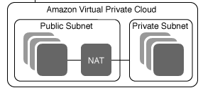
AWS TopLevel Picture
Boundary Objects appear in Front-presentation
HTML with JavaScript
λ
RDS

Slide 32
AWS TopLevel Picture
LambdaFunction JAR files uploaded to same S3 bucket
Treat S3 as a cloud-based file system
λ
RDS

Slide 33
AWS TopLevel Picture
API Gateway
Published API you have constructed in AWS console
Theoretically possible to automate from YAML file
λ
RDS

Slide 34
AWS TopLevel Picture
Lambda Functions execute on cloud host
USEast-1 or wherever your account is located
Takes 2-3 seconds to spin up the host to launch the function
λ
RDS

Slide 35
AWS TopLevel Picture
RDS stores database
Accessible via MySQL workbench and from Lambda Function
λ
RDS

Slide 36
Distributed Computing Myths [Gosling]
The network is reliable
Latency is zero
Bandwidth is infinite
The network is secure
Topology doesn’t change
There is one administrator
Transport cost is zero
The network is homogenous
We are addressing these concerns by using a platform built for scalability
When the programmer has the illusion that result = f(x); for distributed computation.
Each myth is replaced by a specific (often quantifiable) constraint on the design space.
Patterns have been developed to address these very real concerns.
[URL]

Slide 37
Introduction to Web Services (2010)
A Web Service is a software system designed to support interoperable machine-to-machine interaction over a network [W3]
It has an interface described in a machine-readable format (specifically WSDL)
Web-Service Definition Language
Other systems interact with the Web Service in a manner prescribed by its description using SOAP messages in conjunction with other Web-related standards
Agents are central idea
[URL]

Slide 38
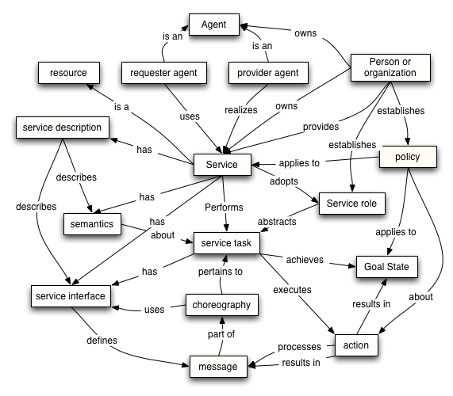
All Clear?
[URL]

Slide 39
Agents and Services
A web service is an abstract notion implemented by a concrete agent
The agent is the concrete piece of software or hardware that sends and receives messages
Agent can only be defined after service definition
The service is the resource characterized by the abstract set of functionality that is provided
Service can be defined independent of an agent

Slide 40
Big Picture
Parties learn of each other’s existence
Agree on semantics & web service definition (WSD)
Construct agents with these semantics and WSD definitions (one for provider and one for requester)
Agents interact with each other

Slide 41
Big Picture
1. Parties learn of each other’s existence
Requester Entity
Provider Entity
Sem.
WSD
2. Agree on semantics & definition (WSD)
Sem.
WSD
Sem.
WSD
Requester Human
Provider Human
3. Input Semantics & WSD
3. Input Semantics & WSD
Requesting
Agent
4. Interact
Providing
Agent

Slide 42
Standards
It doesn’t matter exactly how you specify the semantics
It only matters that a standard is agreed upon by sufficient numbers of developers
WS-* standards are the de facto standards
There are a lot of them
They changed and evolved
They overlap at times (and offer choices)

Slide 43
Common Roles in Web Services
Service provider
Web service invoked via an external source
Web service provides published service description
Service requestor
Web service invokes service provider by sending it a message
Web service searches for and assesses most suitable service provider from available service descriptions
Roles not mutually exclusive

Slide 44
Canonical Example
How can Web Service A and Web Service B communicate with each other?
Service A
Service B
WSDL Defn. for Svc. B
WSDL Defn. for Svc. A

Slide 45
Additional Web Services Roles
Intermediaries
Active/Passive
Initial senders
Ultimate receivers
To be an ultimate receiver a web service MUST provide a WSDL definition
Service composition
Structured assembly of services working towards a common purpose

Slide 46
Combining Roles
Service A
Service B
Service C
Initial sender
Service requestor
Service provider
Service requestor
Intermediary service
Service provider
Ultimate receiver

Slide 47
Web Services Definition (WSD)
Fundamental technology standard associated with designing Web services
A WSDL contains
Abstract Description to establish interface of web service without reference to technology used to host or enable the service to transmit messages
Concrete Description to bind the abstract interface definition to a physical transport protocol

Slide 48
Sample SOA Reference Architecture

Slide 49
Universal Description Discovery & Integration
Web services are meaningful only if potential users find information sufficient to permit their execution
UDDI defines a set of services to support description and discovery of
(1) businesses, org’s, and other Web services providers
(2) the Web services they make available, and
(3) the technical interfaces which may be used to access those services
Based on a common set of industry standards
including HTTP, XML, XML Schema, and SOAP

Slide 50
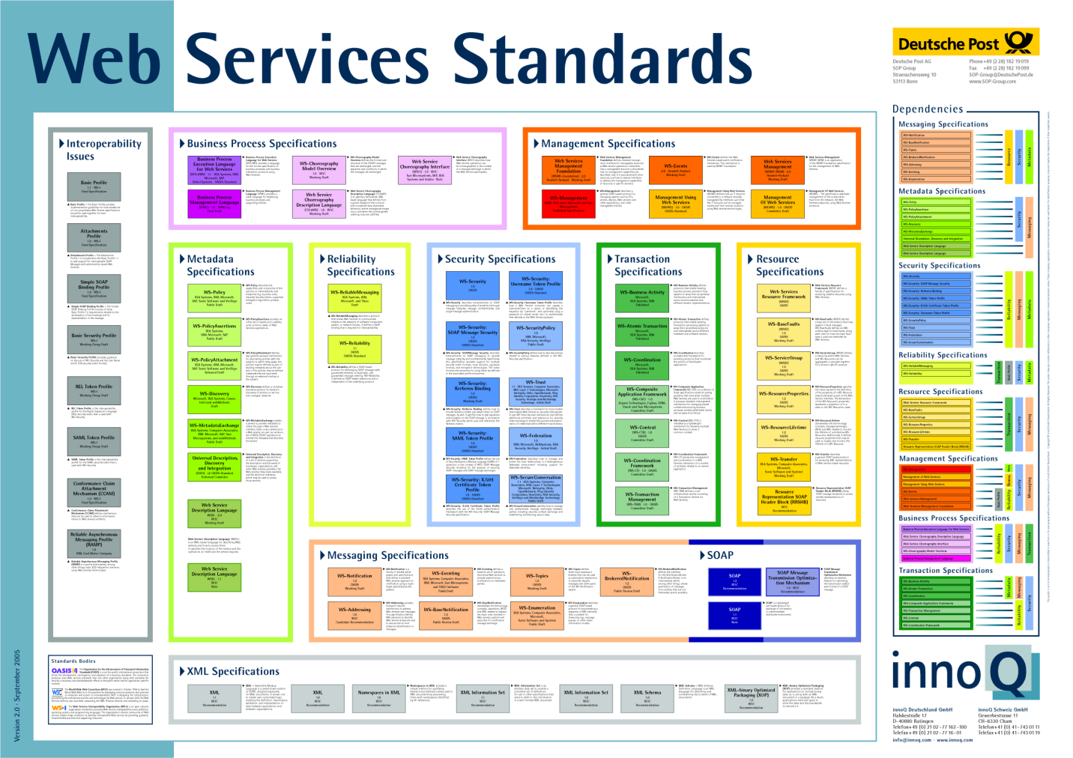
Web Services Wall of Standards
[URL]

Slide 51
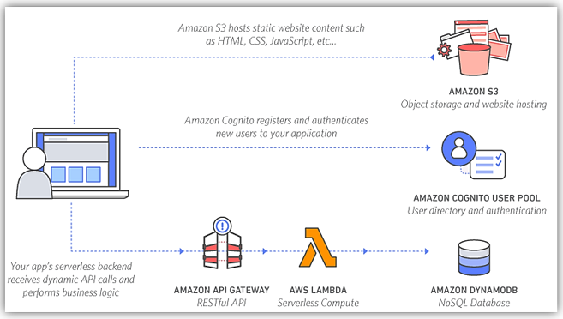
Transition To Cloud Platform
Alternative model we will use in this class
https://aws.amazon.com/serverless/build-a-web-app/

